Slide 1
RCD and functional testing
PowerPoint presentation
Unit 304: Electrical Installations: inspection, testing and commissioning

Slide 2
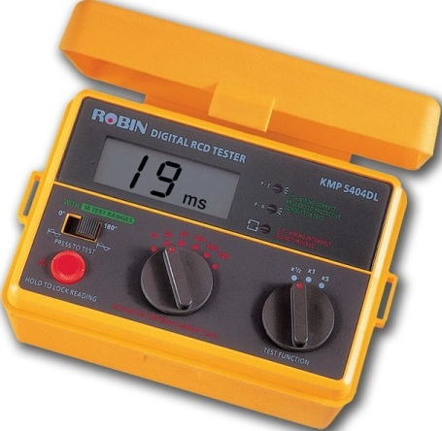
RCD and functional testing
Operation of RCDs
The object of the test is to verify the effectiveness of the residual current device, that is, it is operating with the correct sensitivity and proving the integrity of the electrical and mechanical elements.

Slide 3
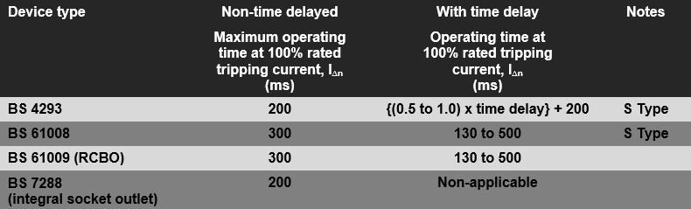
RCD and functional testing
RCD operating times

Slide 4
RCD and functional testing
Additional protection
Where an RCD with a rated residual operating current, I_{∆n}, not exceeding 30mA is used to provide additional protection in the event of a failure of basic protection and/or the provision for fault protection or carelessness of users, the operating of the device must not exceed 40 ms when subjected to a test current 5 x I_{∆n}.
The maximum test time should not exceed 40 ms, unless the protective conductor potential rises by less than 50V. (The instrument supplier will advise on compliance).

Slide 5
RCD and functional testing
Integrated test device
An integral test device is incorporated in each RCD. This device enables the electrical and mechanical parts of the RCD to be verified, by pressing the button marked ‘T’ or ‘Test’.
Operation of the integral test device does not provide a means of checking:
the continuity of the earthing conductor or the associated circuit protective conductors,
any earth electrode or other means of earthing, or
any other part of the associated installation earthing, or
the sensitivity of the device.
The test button will only operate the RCD if the device is energised.
Confirm that the notice to test RCDs quarterly (by pressing the test button) is fixed in a prominent position.

Slide 6
RCD and functional testing
Other functional testing
All assemblies, including switchgear, controls and interlocks, should be functionally tested, that is operated to confirm that they work and are properly installed, mounted and adjusted.

Slide 7
Any questions?

